Slide 1

DEPARTMENT OF COMPUTER SCIENCE AND ENGINEERING
Project name : Flood Monitoring and Early Warning
Team name : Proj_224785_Team_4
Team members:
ASHOK KUMAR A(113321104005)
GIRISH KUMAR VV(113321104023)
HARI KRISHNAN R(113321104026)
MOHAMED FAIZ M(113321104060)

Slide 2
Innovation
Real-time Data Collection: Implement sensors and data collection devices in flood-prone areas to continuously monitor water levels and weather conditions. This data should be collected in real-time and transmitted to a central database.
Automated Alerts: Develop an automated alert system that can send notifications to local authorities and residents when water levels rise above safe thresholds. Alerts can be delivered via SMS, mobile apps, or email to ensure timely response.
Predictive Analytics: Use historical data and advanced analytics to create predictive models that can forecast flood events. This can help in proactive planning and resource allocation for flood mitigation and response.
User-Friendly Interface: Create a user-friendly interface for accessing flood information. This could be a website or a mobile app that provides real-time updates, flood maps, and safety tips to help residents make informed decisions during floods.

Slide 3
Project Objectives
Early Warning and Alert System: Developing an effective early warning and alert system is crucial as it directly contributes to public safety by providing timely notifications of potential flood events.
Accuracy and Reliability: Ensuring the accuracy and reliability of collected data is fundamental to minimizing false alarms and errors, which in turn helps build trust in the monitoring system.
Data Analysis and Reporting: Implement data analysis tools to generate reports and insights from the flood monitoring data, aiding in decision-making and post-flood analysis.
Collaboration: Foster collaboration with relevant government agencies, local communities, and technology partners to ensure the success and effectiveness of the flood monitoring system.

Slide 4
Project Requirements
SOFTWARE:
Arduino IDE: Set up the Arduino IDE (Integrated Development Environment) on your computer to write, upload, and test the Arduino code.
Arduino Programming: Write, understand, and modify the Arduino code provided, focusing on integrating the ultrasonic sensor data, LCD display, LEDs, and buzzer for appropriate functionality.
Understanding Ultrasonic Sensor: Gain a thorough understanding of how the ultrasonic sensor operates, including triggering and receiving ultrasonic waves, and how to calculate distance based on the wave's travel time.
User Interface: Code the logic to display the measured distance and relevant status messages on the LCD display. Implement code to control the LEDs and activate the buzzer based on predefined distance ranges, providing visual and audio feedback.
Testing and Calibration: Calibrate the system to ensure accurate distance measurements using the ultrasonic sensor. Conduct testing under various conditions to validate the accuracy and functionality of the system.
HARDWARE:
Arduino Board: Choose and utilize a compatible Arduino board (e.g., Arduino Uno, Arduino Nano) to interface with sensors and control components.
Ultrasonic Sensor: Acquire an ultrasonic sensor (e.g., HC-SR04) to measure distances using ultrasonic waves and connect it to the Arduino board.
LCD Display: Integrate a suitable LCD display (e.g., 16x2 LCD) to show the measured distance and relevant status messages.
LEDs: Implement LEDs to provide visual indications based on the measured distance. Connect LEDs to the Arduino board.
Buzzer: Include a buzzer to offer audio alerts based on the distance measurements and connect it to the Arduino board.
Wiring and Connections: Properly wire and connect all the hardware components, ensuring correct pin configurations and secure connections.

Slide 5
Components
Name | Quantity | Component
U1 | 1 | Arduino Uno R3
DIST1 | 1 | Ultrasonic Distance Sensor
D1 | 1 | White LED
D2 | 1 | Green LED
D3 | 1 | Yellow LED
D4 | 1 | Red LED
U2 | 1 | LCD 16 x 2
Rpot1 | 1 | 250 Ω Potentiometer
PIEZO1 | 1 | Piezo
R1 R2 R3 R4 R5 | 5 | 1 kΩ Resistor

Slide 6
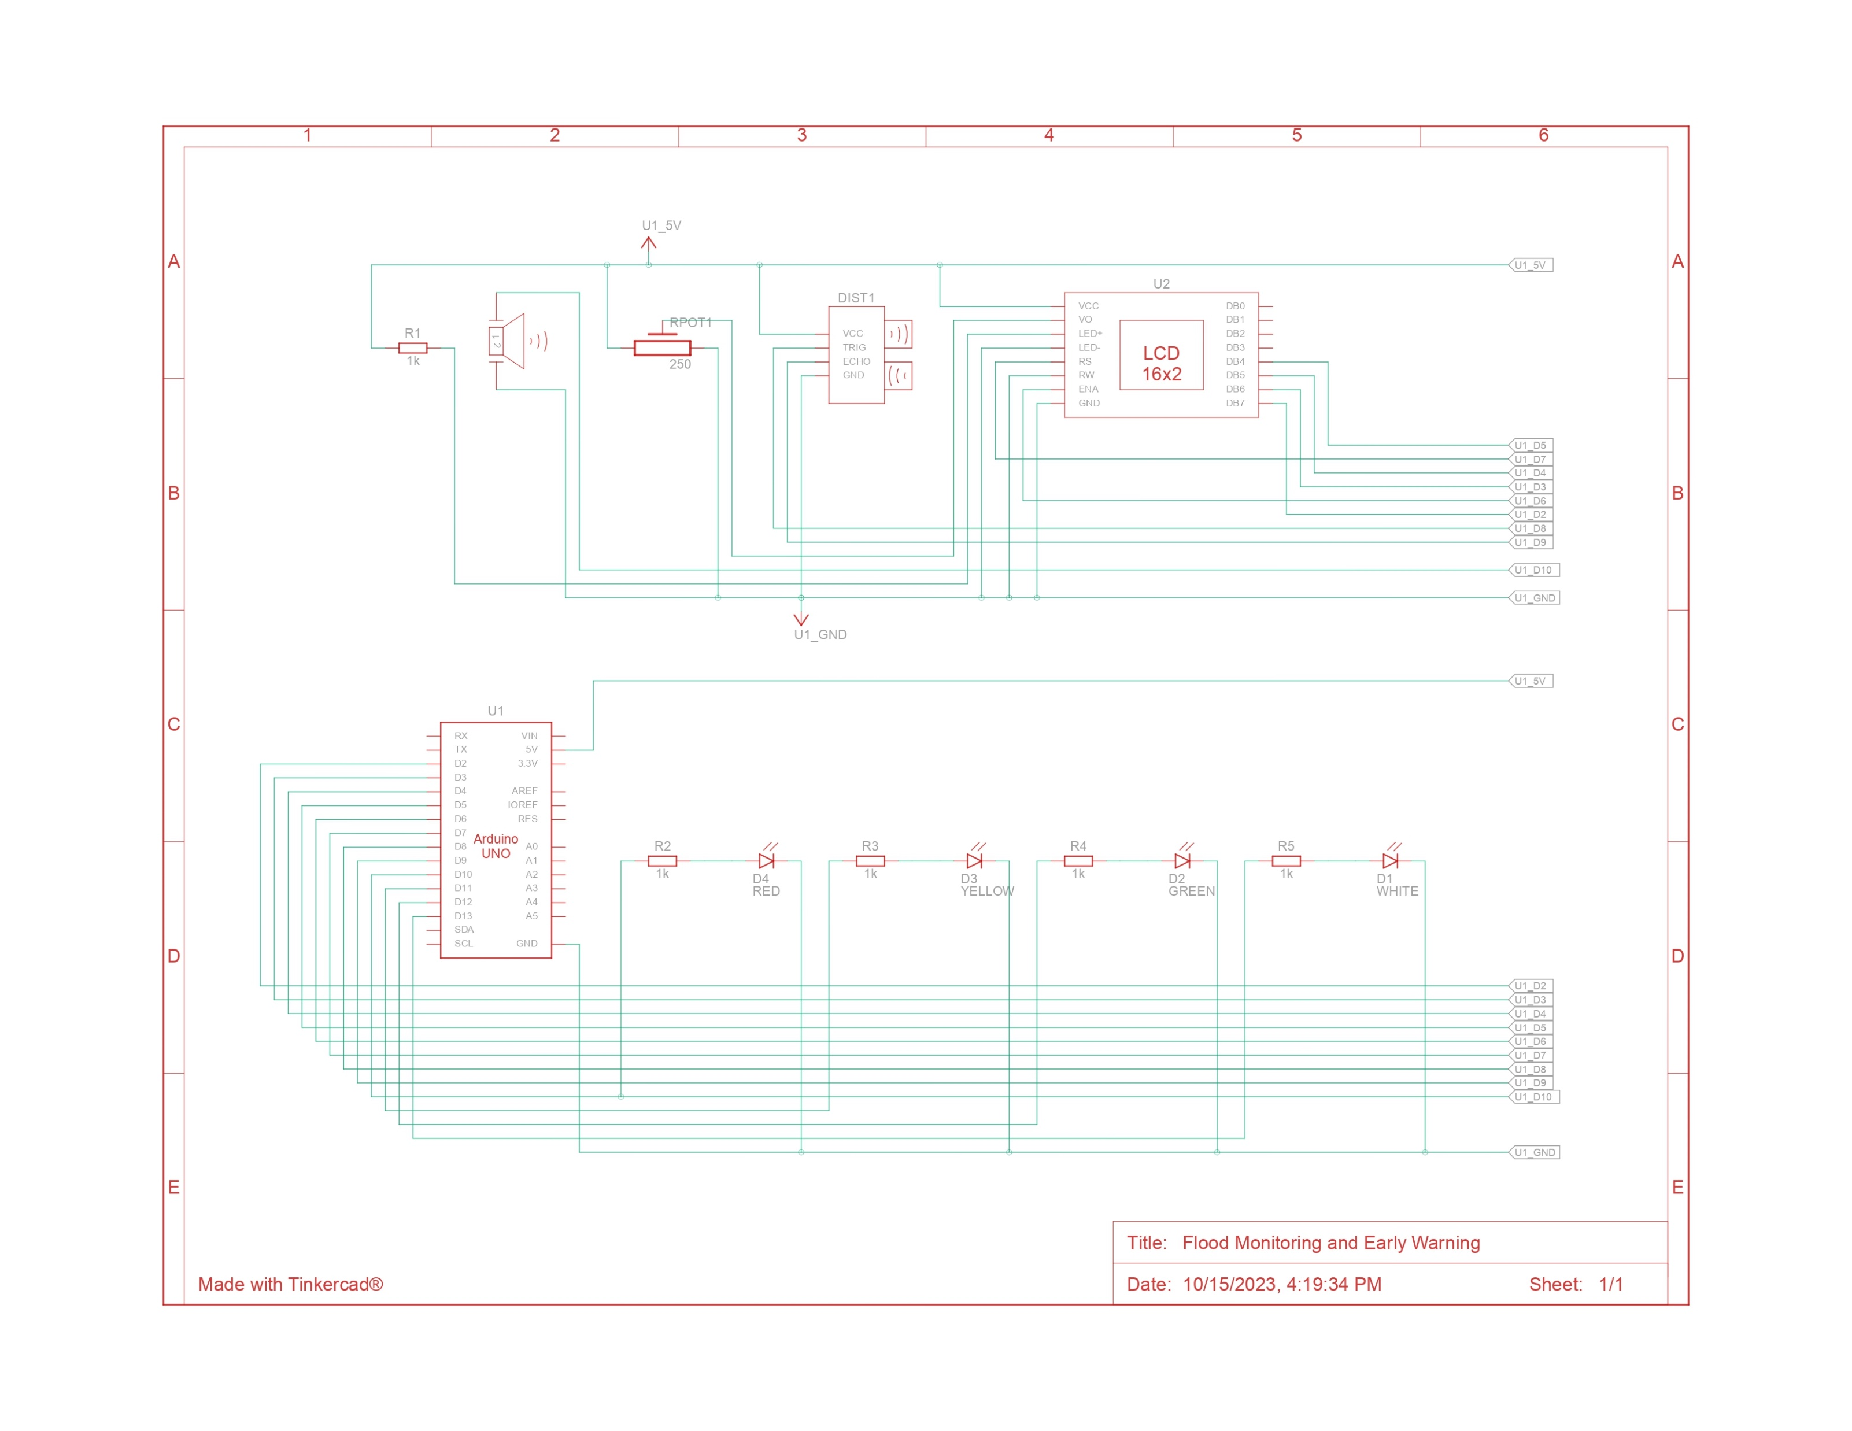
Arduino Integration

Slide 7
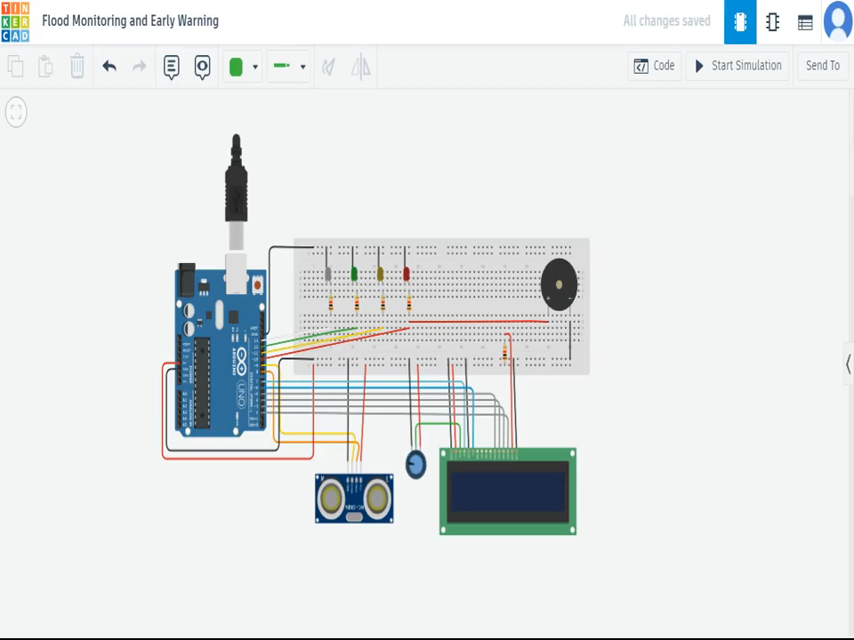
Implementation and Simulation
(Watch the simulation video below)

Slide 8
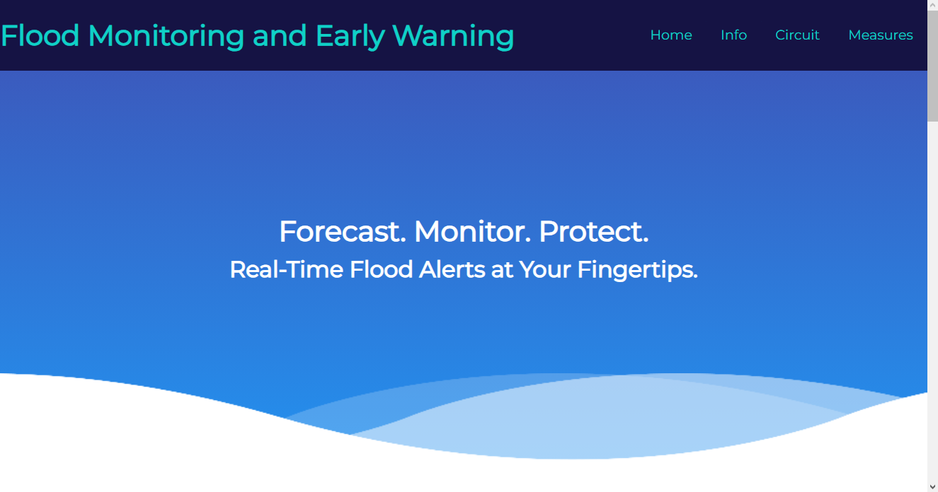
Real time Site
Click here to Explore

Slide 9
THANK YOU

